Slide 1


SATYA
THE RESUME ASSISTANT

Slide 2
INTRODUCTION
The AI system, Satya, was developed to assist HR professionals in analyzing résumés and recommendation letters. The goal of the project is to detect fraudulent candidates and provide insights on candidates’ professional networks, skills, and qualifications.
This report outlines the methodology used to train Satya to assess candidate profiles, detect fraud, and present actionable insights through an interactive dashboard. Our approach emphasizes accuracy, fairness, and scalability, ensuring that Satya can process large datasets beyond the 1,000- candidate limit of the competition.

Slide 3
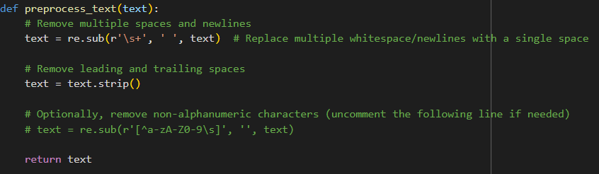
Methodology
2.1 Data Preprocessing
The dataset required careful preprocessing to normalize text-based fields (e.g., converting text to lowercase, removing special characters) and handle missing or incomplete data.
Steps in Preprocessing:
Text Cleaning:
Remove special characters
Normalize letter case
Tokenize text data
Feature Extraction:
Extract key details like :
Number of degrees
Number of skills :Human and tecnical skills
Certificates
Qualities

Slide 4
2.2 Fraud Detection Model
Fraud Detection Approach:
To detect fraud, we used a combination of natural language processing (NLP) and machine learning techniques:-
NLP-based Claim Verification: Cross-check claims in the résumé (e.g., job titles, skills) with those in the recommendation letters to identify inconsistencies.
Anomaly Detection: Using NLP we detected some key terms in the recommendation letters that explained exaggerated words or made the recommendation letter look overly positive.
Mokoto
Mokoto

Slide 5
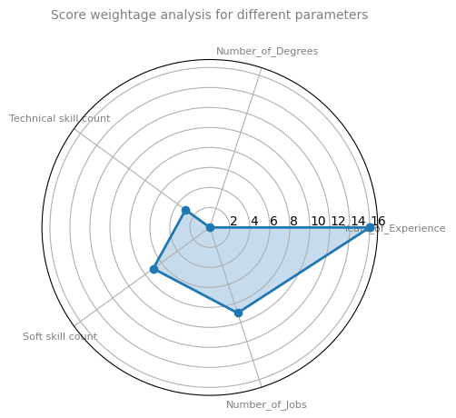
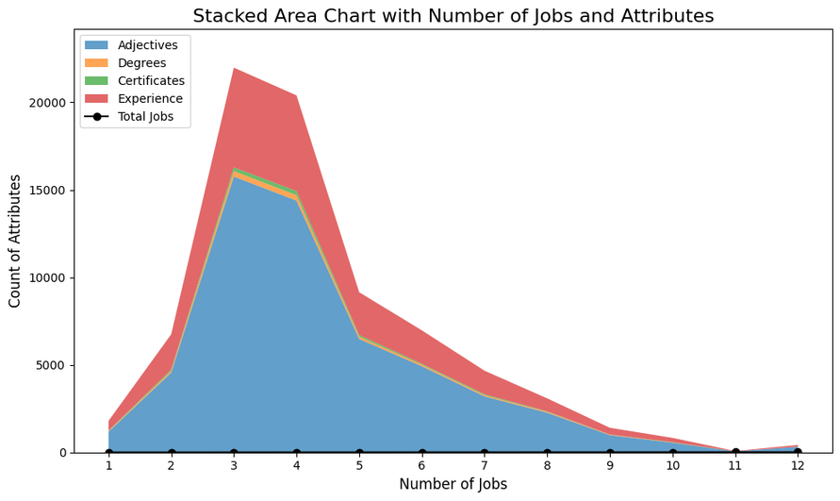
2.3 Resume Score Analysis Key
Metrics for Resume Score Analysis:
Experience
Degrees
Qualities by recommender
Skills
Previous jobs
Certificates

Slide 6
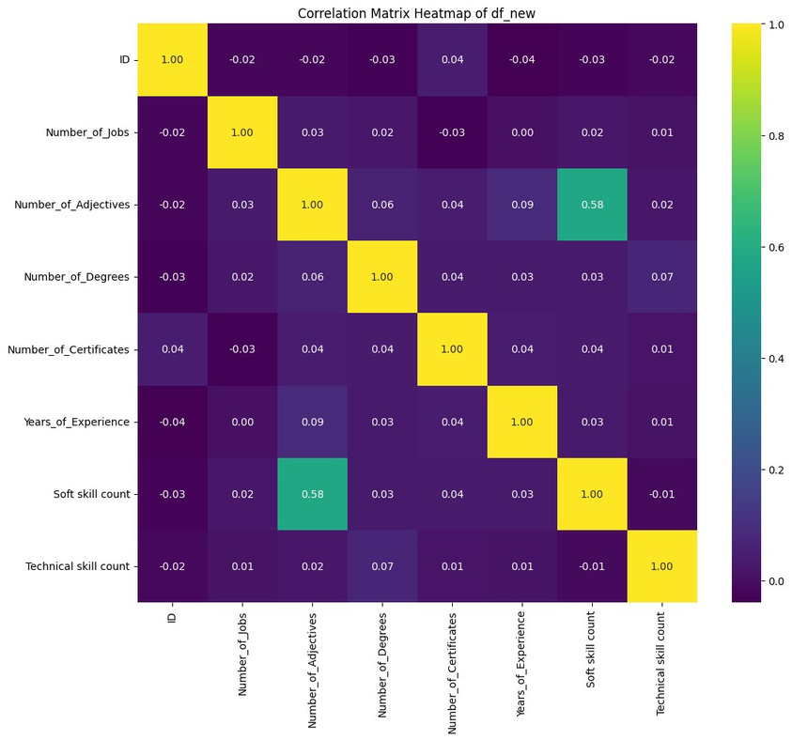
HEATMAP
On the basis of our analysis done using graphs like heatmap we analysed correlations and we assigned weights to each of these parameters to get the Resume score value:
Years_of_experience= 0.3
2. Number_of_Degrees= 0.2
3. Number_of_Adjectives= 0.15
4. Technical_Skill_Count= 0.12
5. Soft_Skill_Count= 0.1
6. Number_of_jobs= 0.08
7. Number_of_Certificates= 0.05

Slide 7
4. Bias and Fairness Considerations
4.1 Bias in Recommendations
We detected a bias in recommendations where male candidates were more frequently endorsed for leadership roles than female candidates, despite similar qualifications. To mitigate this, we implemented a fairness metric to balance endorsements and ensure that no group is unfairly advantaged.
4.2 Language Bias
Some recommendation letters used subjective language (e.g., "potential," "enthusiasm") that did not reflect actual achievements. Satya was trained to flag such vague language for further human review.

Slide 8
5. Scalability and Optimizations
5.1 Scalable Architecture
We designed Satya with scalability in mind by using a cloud-based architecture, allowing it to process larger datasets efficiently. The system uses distributed computing to handle parallel processing tasks for thousands of candidates.
5.2 Optimizations Text Vectorization:
Optimized the NLP pipeline using TF-IDF vectorization, reducing computation time. Model Tuning: Applied hyperparameter tuning using grid search to optimize the performance of fraud detection and network analysis models.

Slide 9
6. Model Based prediction of the weighted labels
We have generated the labels from the understanding of the data and now we want to further use it to other models so we used the best possible state of the art Stacking classifier model where it defined the risk category and the weighted score of the resume. The main thing here is the relation that we thought was true is really true. So we used the random forest classifier weight dependence on different parameters of the data, and we validated that the relation ship that we established is true even for prediction of other labels like it.
Accuracy:98.5%

Slide 10
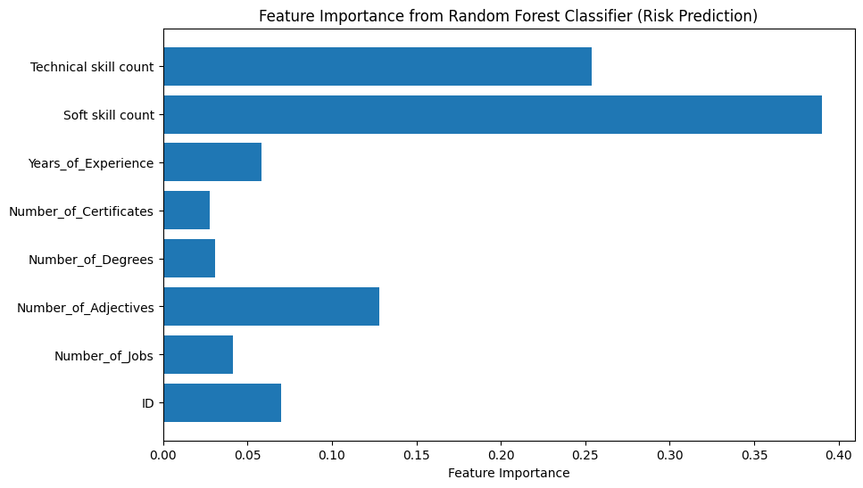
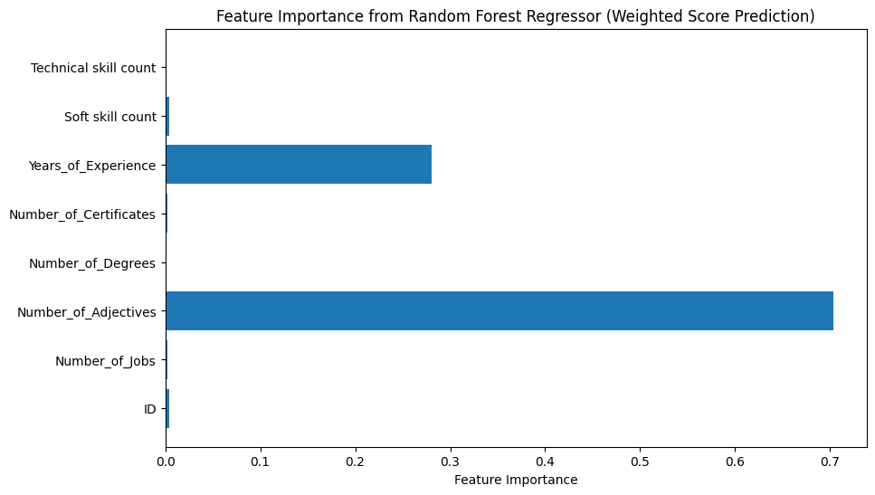
Validation of weight by the ML model

Slide 11
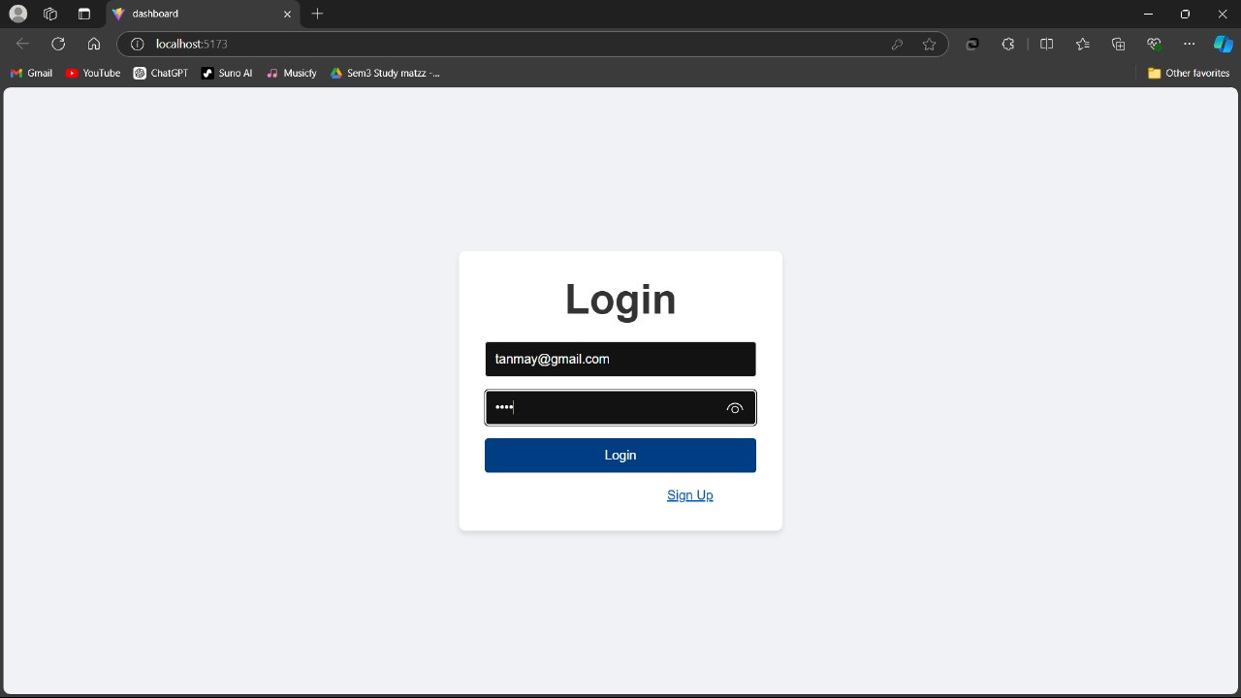
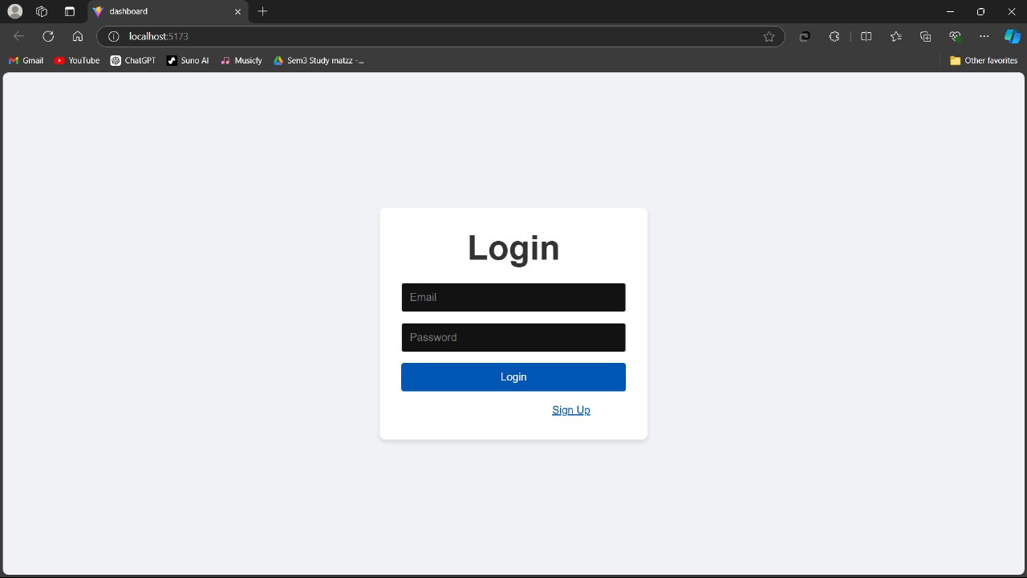
Web Overview

Slide 12
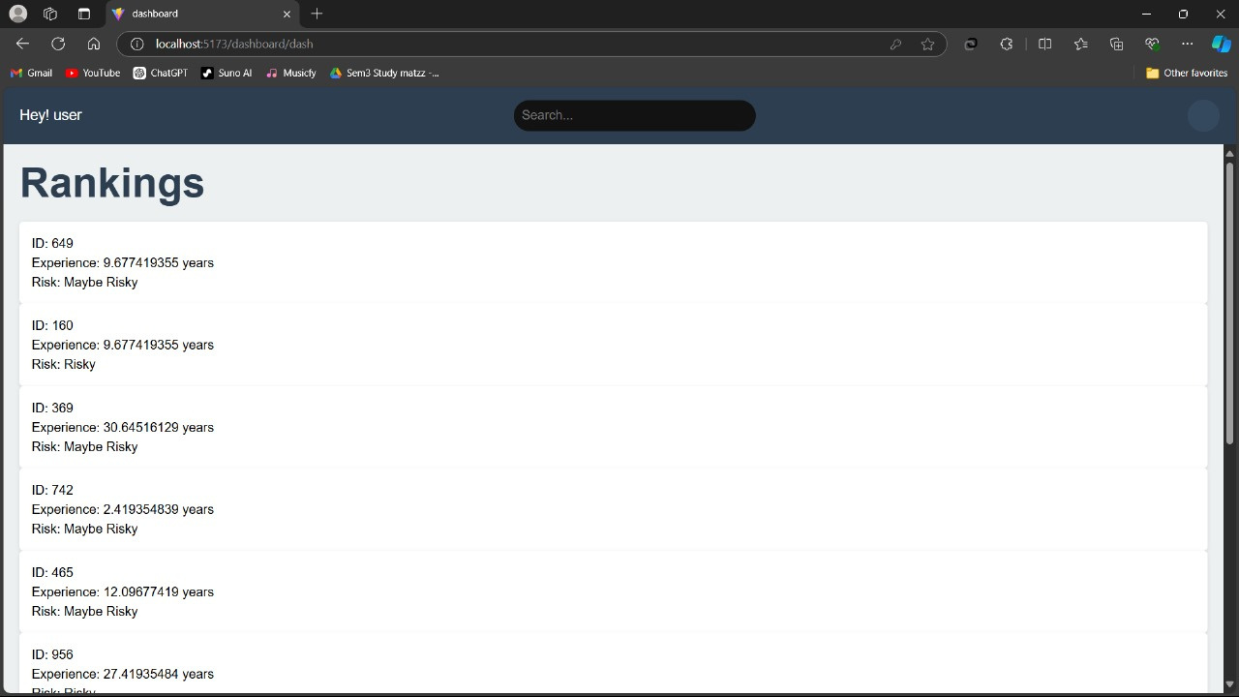
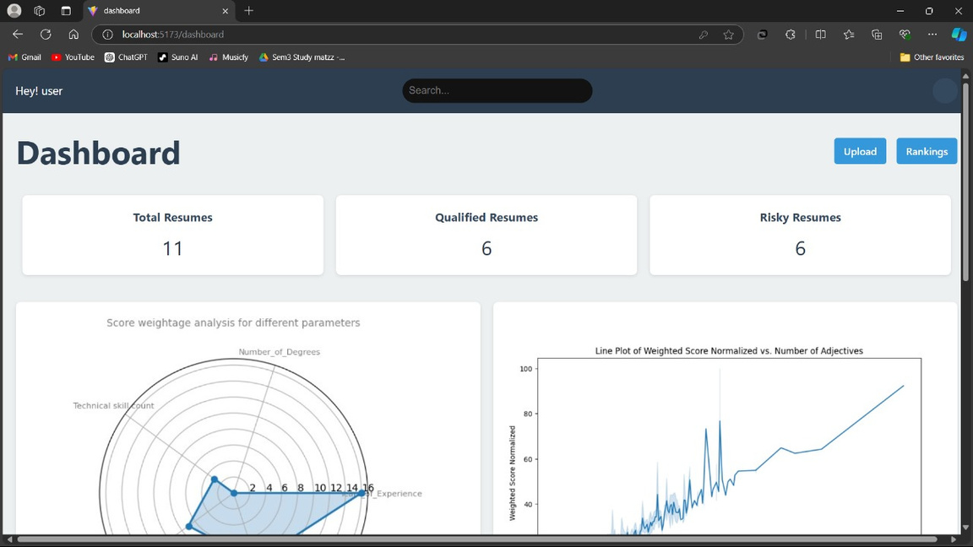

Slide 14
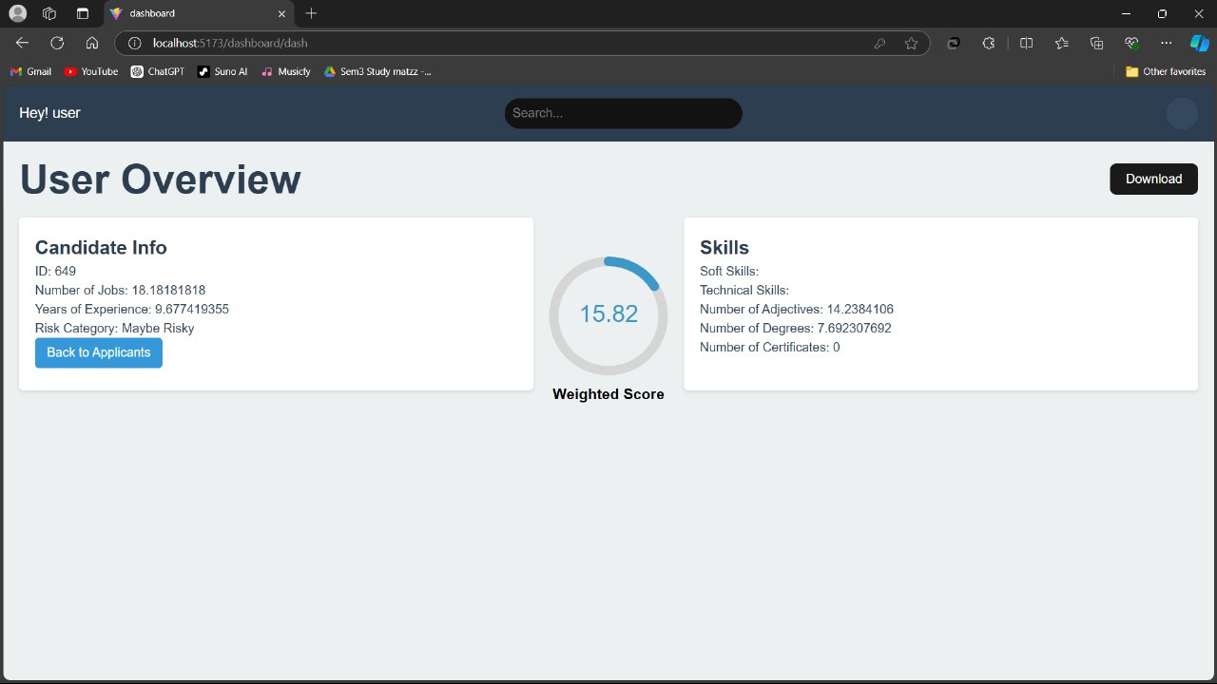
Here is the short Preview of the web interference of the satya ai bot and these the various componenets

Slide 15
Thank
you!

